Slide 1
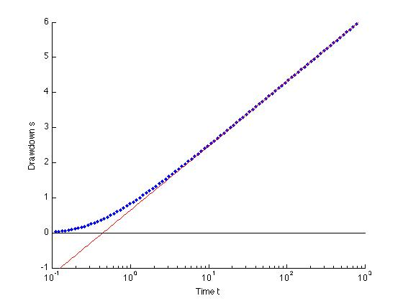
Theoretical Method

Slide 2
Theoretical Method
Δs₁₀=1.8
t=0.4

Slide 3
Graphical Method

Slide 4
Drawdown Data

Slide 5
Well Function

Slide 6
Let’s make the well function 75% transparent

Slide 7
Overlay data on same graph

Slide 8
Locate Match Point on Well Function – (1,1)

Slide 9
Delete Well Function and read off s and t from data
h-h₀=0.8
W=1
u=1
h-h₀=s
t=t
t=0.3

